Slide 1
POLYMORPHISM

Slide 2
Polymorphism
On Earth, the normal state of water is liquid, but water changes to a solid when frozen, and to a gas when heated to its boiling point. This ability to change form is known as polymorphism.
There are two types of polymorphism in java: compile time polymorphism and runtime polymorphism. We can perform polymorphism in java by method overloading and method overriding.

Slide 3
Polymorphism
Compile time polymorphism:
Method Overloading
Runtime polymorphism:
Method overriding

Slide 4
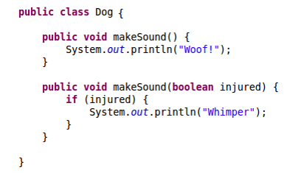
Compile time polymorphism
Dog d = new Dog();
d.makeSound();
d.makeSound(true);
Without running, we can tell which method to call.

Slide 5
Run time polymorphism
Runtime polymorphism is a process in which a call to an overridden method is resolved (deciding what method to call between the superclass and the subclass) at runtime rather than compile-time.
It is also known as Dynamic Method Dispatching or Dynamic Binding.

Slide 6
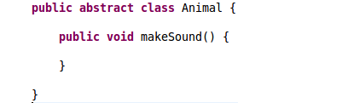
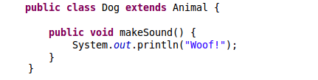
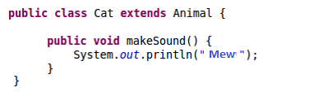
Dynamic binding

Slide 7
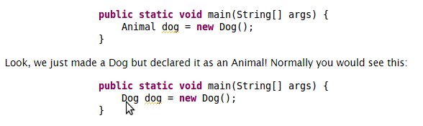

Dynamic binding
wrong

Slide 8
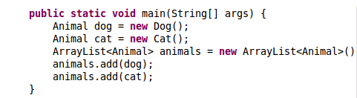
Benefits

Slide 9
Why is it Dynamic?
What if we look at the code and decide what method to call before running the program? Is there any problem with this approach? (static/compile time/early binding)
If yes, does dynamic/run time/late binding solve the problem?

Slide 10
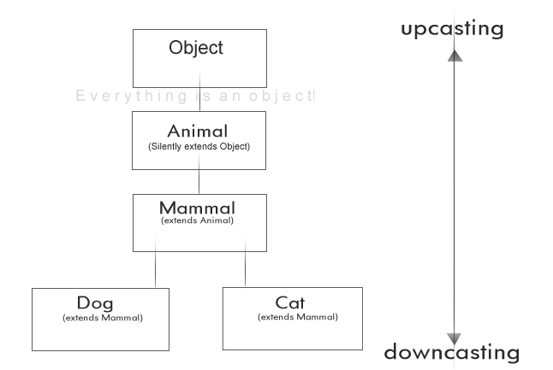
Up casting and Down casting
Up Casting: casting to a super type.
Down Casting: casting to a subtype.

Slide 11


Up casting and Down casting
wrong

Slide 12
REFERENCES
http://www.java-made-easy.com/polymorphism-in-java.html
http://www.cs.utexas.edu/~cannata/cs345/Class%20Notes/14%20Java%20Upcasting%20Downcasting.htm
http://stackoverflow.com/questions/23414090/what-is-the-difference-between-up-casting-and-down-casting-with-respect-to-class
http://www.javatpoint.com/runtime-polymorphism-in-java

